Slide 1

Shiny App Workshop (I)
ISSS 616 Applied Statistical Analysis with R (ASAR)
January 2023
SMU School of Computing and Information Systems
Masters of IT in Business AY 2022-2023 – Term 2

Slide 2
Data Wrangling

Slide 3
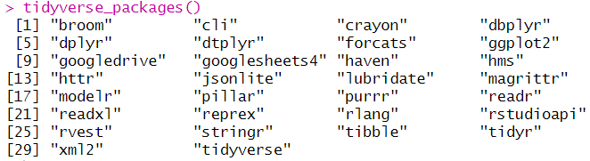
Tidyverse
A set of packages for data visualization and manipulation: e.g ggplot2, dplyr, tidyr etc.
Code | Syntax
%>% | pipe operator for chaining a sequence of operations
glimpse() | get an overview of what’s included in dataset
filter() | filter rows
select() | select, rename, and reorder columns
arrange() | reorder rows
mutate() | create a new column
group_by() | group variables
summarize() | summarize information within a dataset
rename() | rename columns
left_join() | combine data across data frame
count() | get counts of unique values of specified column(s)
install.packages("tidyverse")
library(tidyverse)

Slide 4
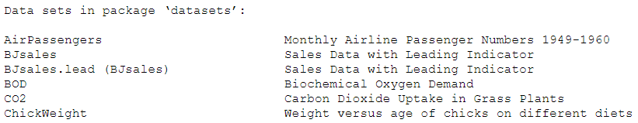
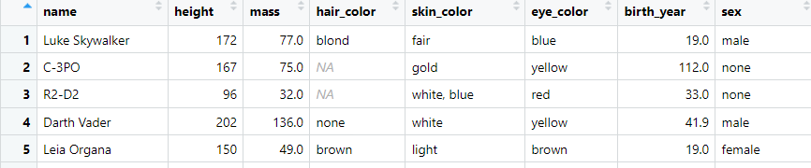
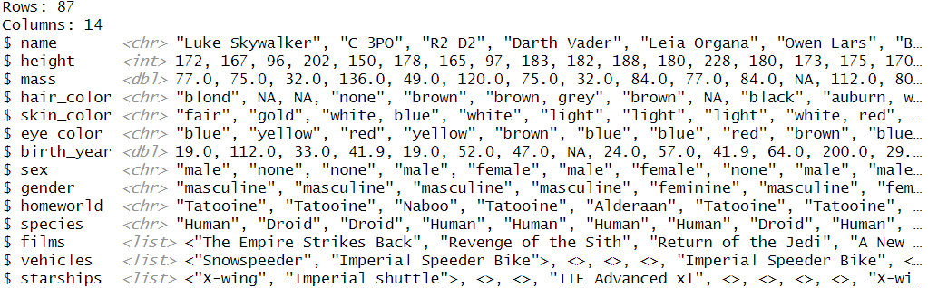
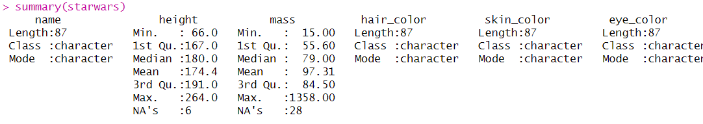
Dataset: starwars
#view available datasets
data()
#spreadsheet-style viewer
view(starwars)
#view all columns
glimpse(starwars)
#data summary
summary(starwars)
Notes:
Fluid page
User interface
Titlepanel
sidebarLayout/sidebarPanel + mainpanel
SliderInput
mainPanel

Slide 5
Pipe operator %>%
Call the function B on the data frame object A:
B(A)
Alternatively:
A %>% B (Take A then B)
Take data frame A and carry out function B, then you want to take the output from that and then carry out function C. Subsequently you want to take the output of that and then carry out function D:
D(C(B(A)))
Alternatively:
A %>% B %>% C %>% D
More readable: each function in its own line with indentation
A %>%
B %>%
C %>%
D
Shortcut for pipe operator:
Ctrl + Shift + M (Windows)
Cmd + Shift + M (Mac)

Slide 6
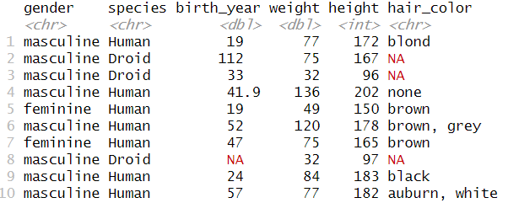
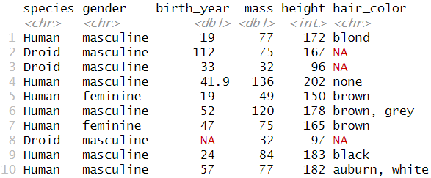
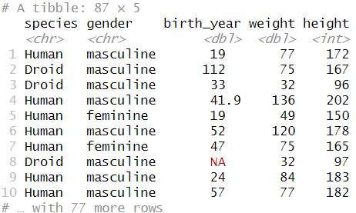
Select columns: Select()
Select columns by name
Columns appear in the order specified
Rename columns
starwars %>%
select(gender, species, birth_year, "weight"= mass, height, hair_color)
starwars %>%
select(species, gender, birth_year, mass, height, species, hair_color)
starwars %>%
select(species, gender, birth_year, mass, height) %>%
rename(weight=mass)

Slide 7
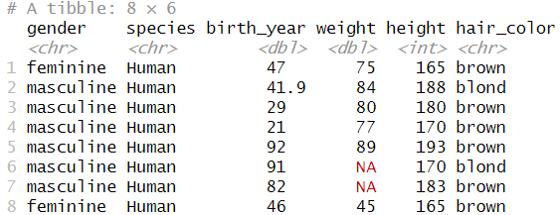
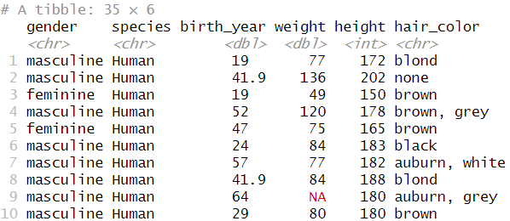
Filter data: filter()
starwars %>%
select(gender, species, birth_year, "weight"= mass, height, species, hair_color) %>%
filter(species=="Human", birth_year>20, hair_color %in% c("blond","brown"))
Select observations that matches specific conditions
starwars %>%
select(gender, species, birth_year, "weight"= mass, height, species, hair_color) %>%
filter(species=="Human")

Slide 8
Filter data: filter()
Comparison operators:
“<” less than
“>” greater than
“==” equal to
“<=” less than or equal to
“>=” greater than or equal to
“!=” not equal to
“%in%” matches element in a list
“is.na” is NA
mydata %>% filter(!is.na(var2)))
“!is.na” is not NA
Logical operators:
“&” boolean and
“|” boolean or
“xor” exactly or
“!” not
“any” any true
“all” all true

Slide 9
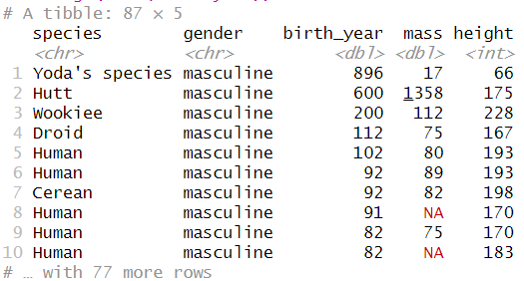
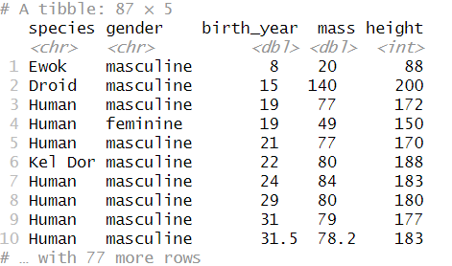
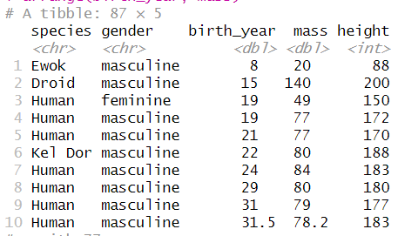
Reordering rows: arrange()
Arrange value in descending order
starwars %>%
select(species, gender, birth_year, mass, height) %>%
arrange(desc(birth_year))
arrange() sorts values in ascending order
Use desc() to sort in descending orders
To reorder rows based on information in multiple columns, specify them separated by commas
starwars %>%
select(species, gender, birth_year, mass, height) %>%
arrange(birth_year)
Arrange value with more than 1 column
starwars %>%
select(species, gender, birth_year, mass, height) %>%
arrange(birth_year, mass)
Notes:
starwars %>%
select(species, gender, birth_year, mass, height) %>%
arrange(birth_year, mass)

Slide 10
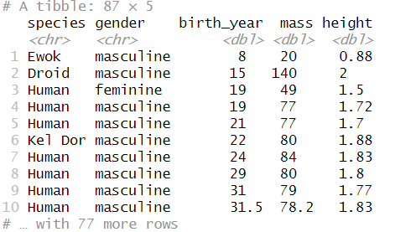
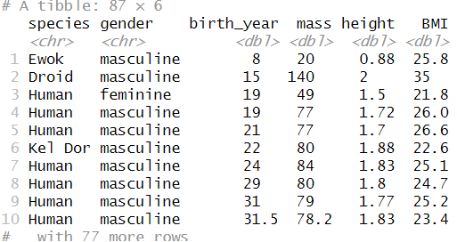
Create new columns or modify columns: mutate()
mutate() adds new variables or modify existing columns
# add variable BMI
starwars %>%
select(species, gender, birth_year, mass, height) %>%
arrange(birth_year,mass) %>%
mutate(height=height/100) %>%
mutate(BMI=mass/height^2)
#convert height in cm to height in m
starwars %>%
select(species, gender, birth_year, mass, height) %>%
arrange(birth_year, mass) %>%
mutate(height=height/100)

Slide 11
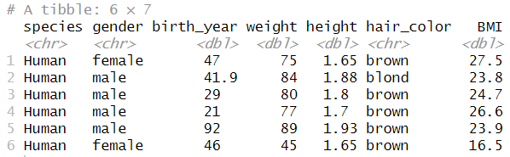
Create new columns: mutate()
Use recode() to change categorical values
starwars %>%
select(species, gender, birth_year, mass, height, hair_color) %>%
filter(species=="Human", birth_year>20, hair_color %in% c("blond","brown")) %>%
rename(weight=mass) %>%
mutate(height=height/100) %>%
mutate(BMI=weight/height^2) %>%
mutate(gender=recode(gender, masculine="male", feminine="female"))

Slide 12
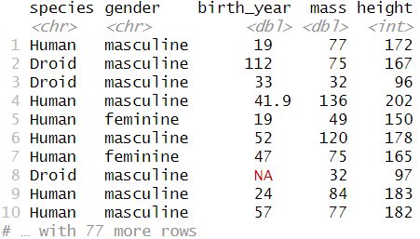
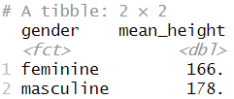
Group data: group_by()
group_by() function groups a dataset by one or more variables
#subsequent statistics affected by group_by()
starwars %>%
select(species, gender, birth_year, mass, height, hair_color) %>%
group_by(gender) %>%
na.omit() %>%
summarize(mean_height=mean(height))
#group_by() does not change the dataset on its own
starwars %>%
select(species, gender, birth_year, mass, height) %>%
group_by(gender)

Slide 13
Shiny Concept + Introduction

Slide 14
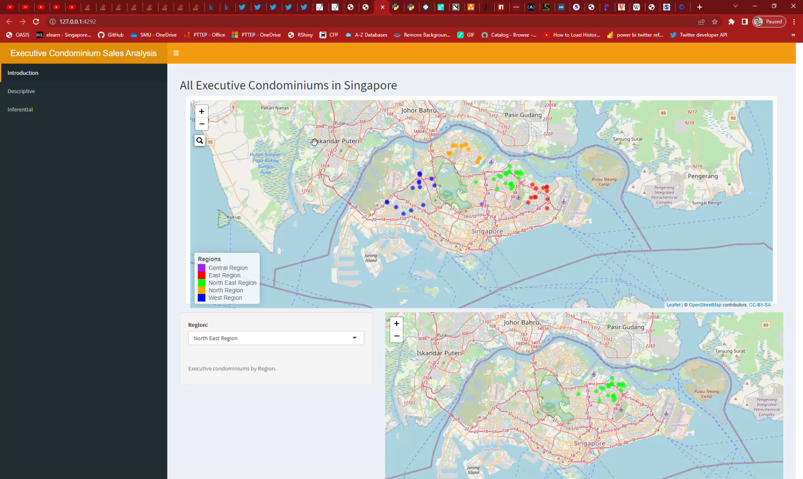
What Shiny Web App can do?

Slide 15
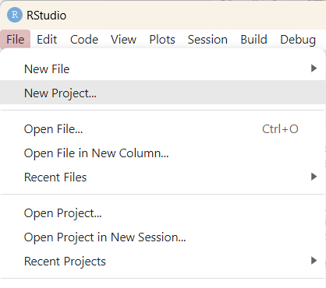
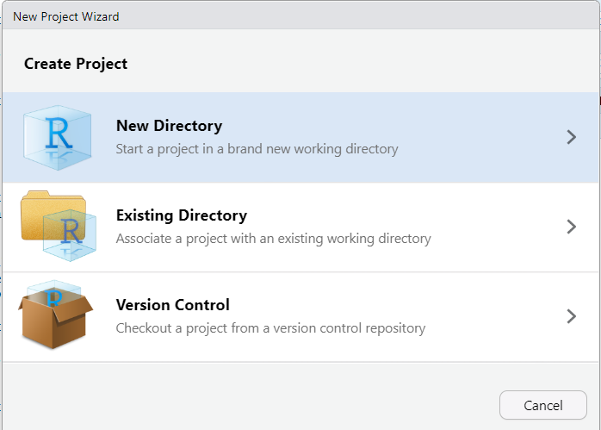
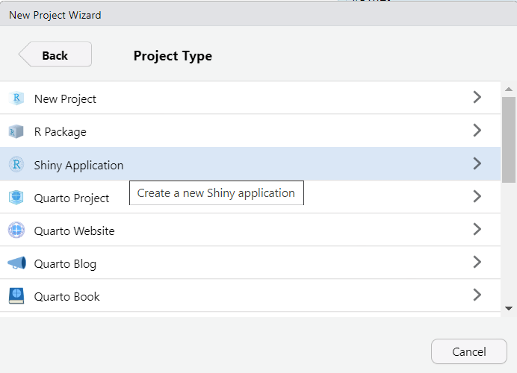
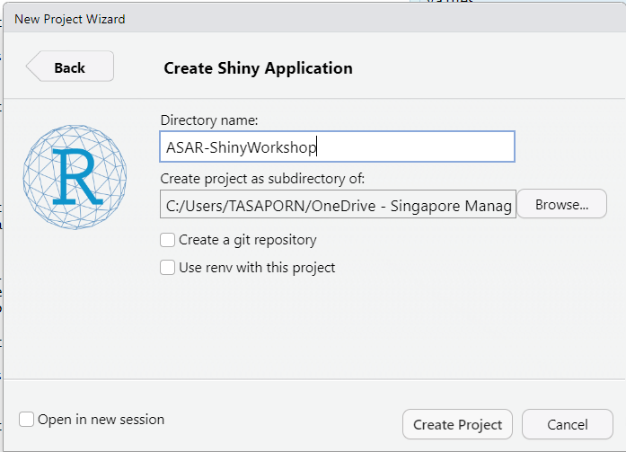
Create Shiny Web App

Slide 16
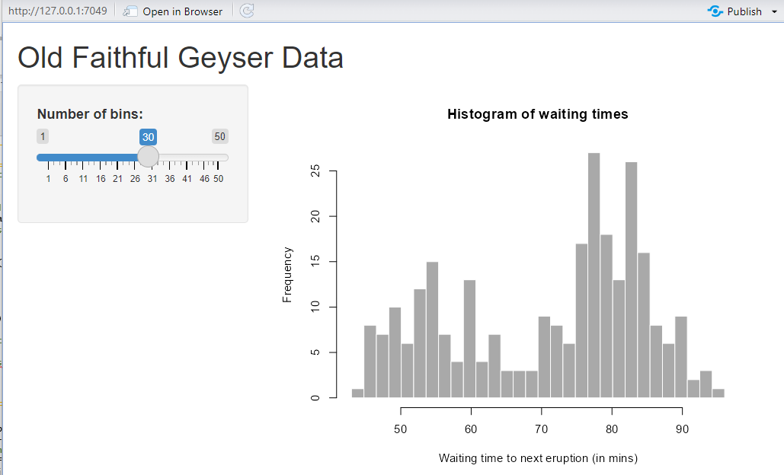
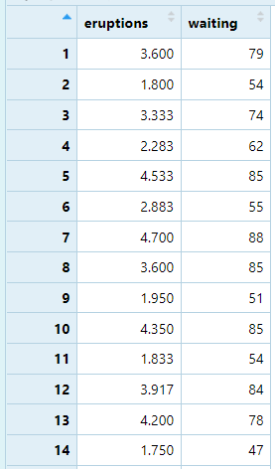
1
Learn from default App
library(shiny)
# Define UI for application that draws a histogram
ui <- fluidPage(
# Application title
titlePanel("Old Faithful Geyser Data"),
# Sidebar with a slider input for number of bins
sidebarLayout(
sidebarPanel(
sliderInput("bins",
"Number of bins:",
min = 1,
max = 50,
value = 30)
),
# Show a plot of the generated distribution
mainPanel(
plotOutput("distPlot")
)
)
)
# Define server logic required to draw a histogram
server <- function(input, output) {
output$distPlot <- renderPlot({
# generate bins based on input$bins from ui.R
x <- faithful[, 2]
bins <- seq(min(x), max(x), length.out = input$bins + 1)
# draw the histogram with the specified number of bins
hist(x, breaks = bins, col = 'darkgray', border = 'white’,
xlab = 'Waiting time to next eruption (in mins)’,
main = 'Histogram of waiting times’)
})}
# Run the application
shinyApp(ui = ui, server = server)
2
3
4
Notes:
Fluid page
User interface
Titlepanel
sidebarLayout/sidebarPanel + mainpanel
SliderInput
mainPanel

Slide 17
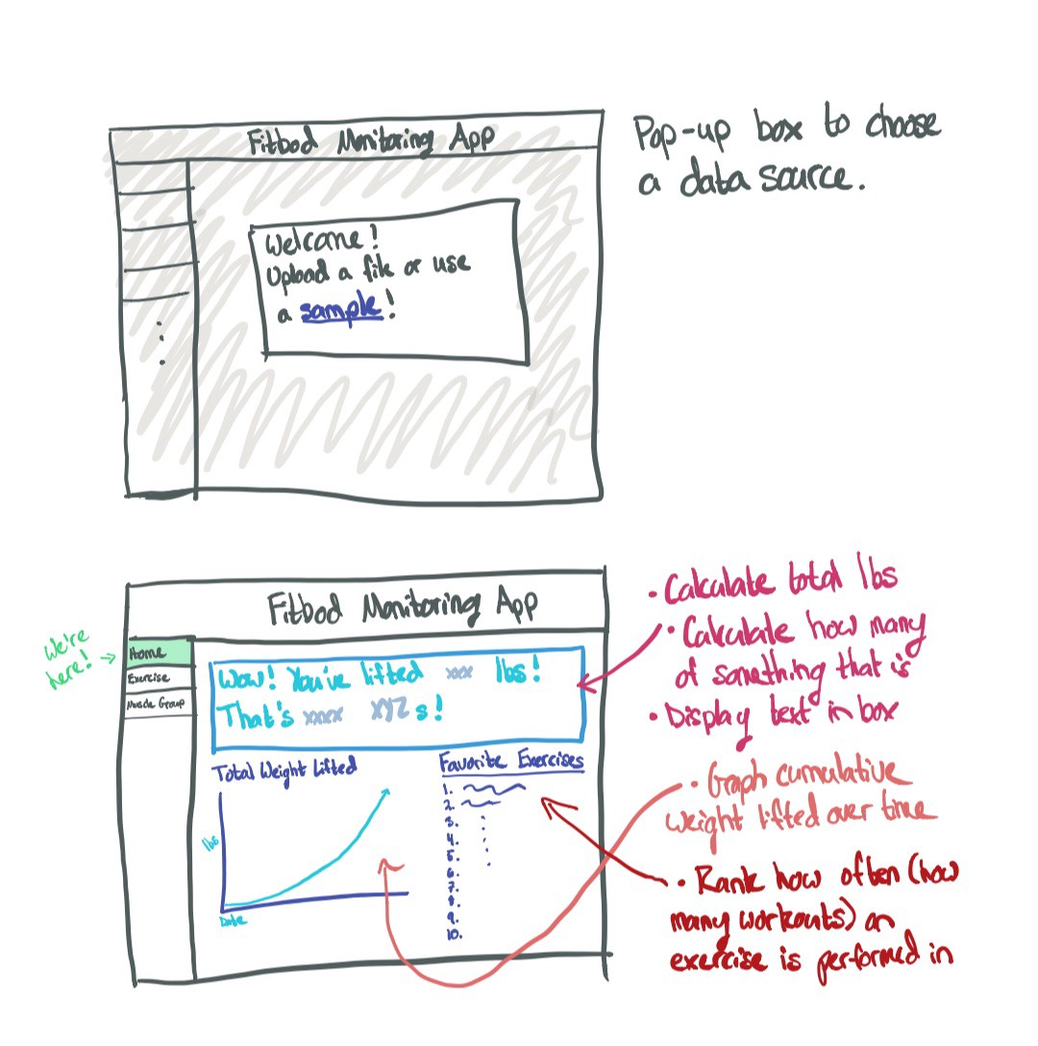
UI wireframe
library(shiny)
# Define UI for application that draws a histogram
ui <- fluidPage(
# Application title
titlePanel("Old Faithful Geyser Data"),
# Sidebar with a slider input for number of bins
sidebarLayout(
sidebarPanel(
sliderInput("bins",
"Number of bins:",
min = 1,
max = 50,
value = 30)
),
# Show a plot of the generated distribution
mainPanel(
plotOutput("distPlot")
)
)
)
# Define server logic required to draw a histogram
server <- function(input, output) {
output$distPlot <- renderPlot({
# generate bins based on input$bins from ui.R
x <- faithful[, 2]
bins <- seq(min(x), max(x), length.out = input$bins + 1)
# draw the histogram with the specified number of bins
hist(x, breaks = bins, col = 'darkgray', border = 'white’,
xlab = 'Waiting time to next eruption (in mins)’,
main = 'Histogram of waiting times’)
})}
# Run the application
shinyApp(ui = ui, server = server)
fluidPage
titlePanel
sidebarPanel
mainPanel

Slide 18
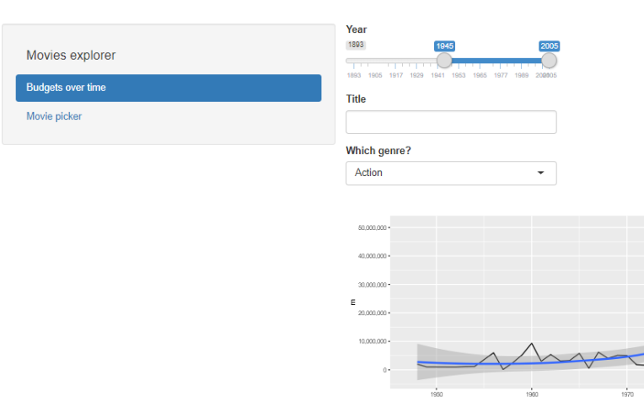
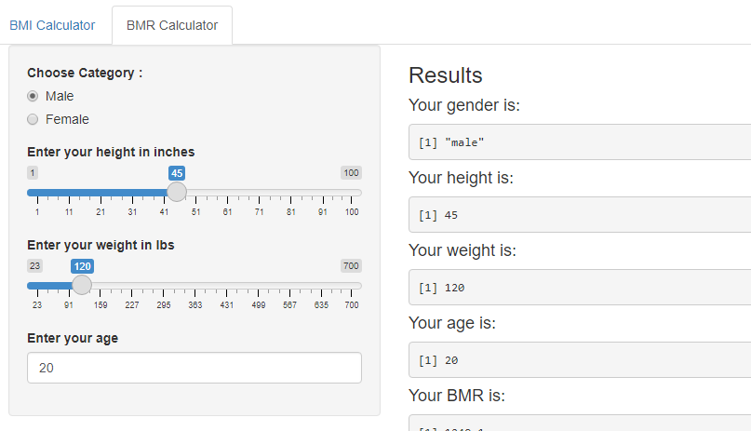
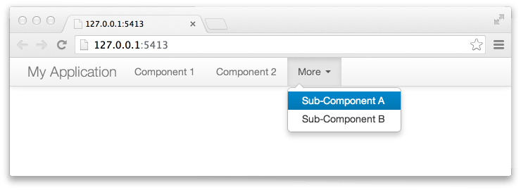
Multi-page layout
tabsetPanel() + tabPanel()
navlistPanel() + tabPanel()
navbarMenu() + tabPanel()
Picture from https://www.oreilly.com/library/view/hands-on-dashboard-development/9781789611557/a38b3024-01d9-4969-a1da-5422a3c7d124.xhtml

Slide 19
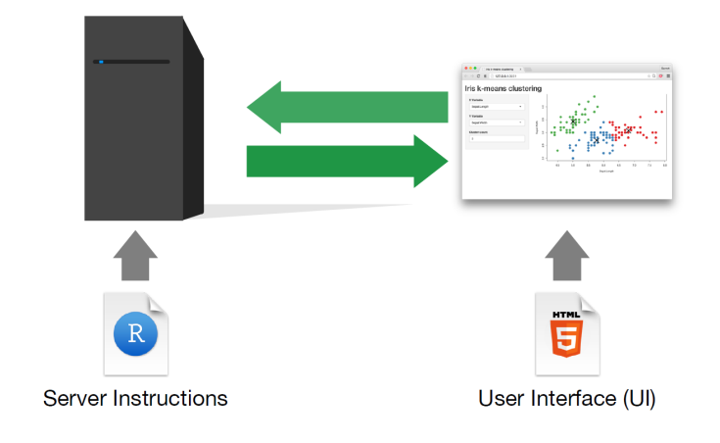
Shiny App architecture
library(shiny)
# Define UI for application that draws a histogram
ui <- fluidPage(
# Application title
titlePanel("Old Faithful Geyser Data"),
# Sidebar with a slider input for number of bins
sidebarLayout(
sidebarPanel(
sliderInput("bins",
"Number of bins:",
min = 1,
max = 50,
value = 30)
),
# Show a plot of the generated distribution
mainPanel(
plotOutput("distPlot")
)
)
)
# Define server logic required to draw a histogram
server <- function(input, output) {
output$distPlot <- renderPlot({
# generate bins based on input$bins from ui.R
x <- faithful[, 2]
bins <- seq(min(x), max(x), length.out = input$bins + 1)
# draw the histogram with the specified number of bins
hist(x, breaks = bins, col = 'darkgray', border = 'white’,
xlab = 'Waiting time to next eruption (in mins)’,
main = 'Histogram of waiting times’)
})}
# Run the application
shinyApp(ui = ui, server = server)
The HTML of Shiny
Front-end
Imagine building a webpage, how do you want to build your layout, what kind of items you want to put, in what position, what tabs
What kind of buttons and interactivity?
The Back-end of your app
Where all the formulas, the coding run

Slide 20
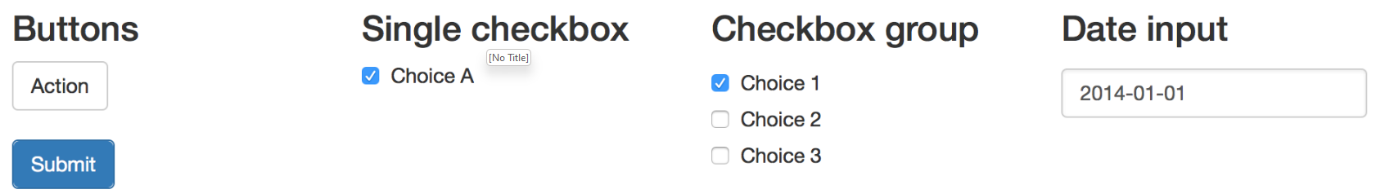
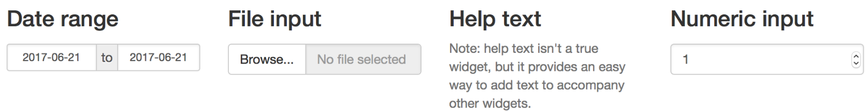
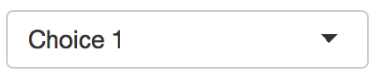
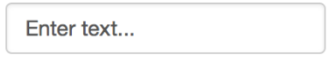
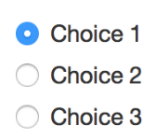
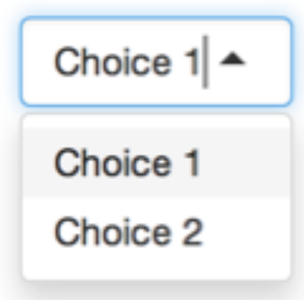
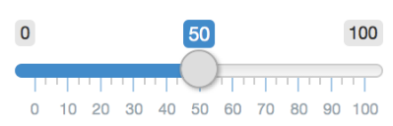
Input Widgets
Link for widget
Cheat sheet
actionButton(inputId, label, icon, width, …) | checkboxInput(inputId, label, value, width) | dateInput(inputId, label, value, min, max, format, startview, weekstart, language, width, autoclose, datesdisabled, daysofweekdisabled) | dateRangeInput(inputId, label, start, end, min, max, format, startview, weekstart, language, separator, width, autoclose)
fileInput(inputId, label, multiple, accept, width, buttonLabel, placeholder) | numericInput(inputId, label, value, min, max, step, width) | selectInput(inputId, label, choices, selected, multiple, selectize, width, size) | textInput(inputId, label, value, width, placeholder)
checkboxGroupInput(inputId, label, choices, selected, inline, width, choiceNames, choiceValues) | radioButtons(inputId, label, choices, selected, inline, width, choiceNames, choiceValues) | sliderInput(inputId, label, min, max, value, step, round, format, locale, ticks, animate, width, sep, pre, post, timeFormat, timezone, dragRange) | selectInput(inputId, label, choices, selected, multiple, selectize, width, size)

Slide 21
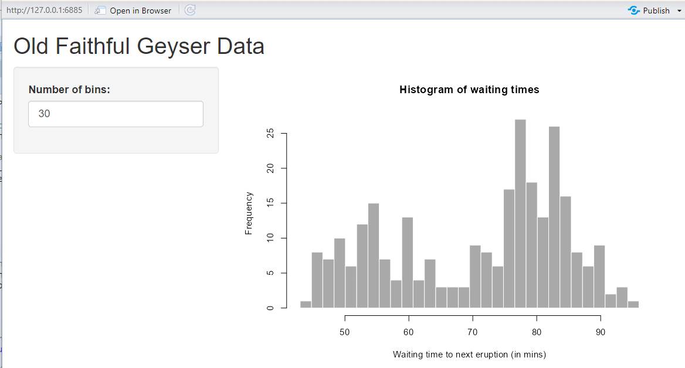
Editing UI Input
library(shiny)
# Define UI for application that draws a histogram
ui <- fluidPage(
# Application title
titlePanel("Old Faithful Geyser Data"),
# Sidebar with a slider input for number of bins
sidebarLayout(
sidebarPanel(
numericInput("bins",
"Number of bins:",
min = 1,
max = 50,
value = 30)
),
# Show a plot of the generated distribution
mainPanel(
plotOutput("distPlot")
)
)
)
# Define server logic required to draw a histogram
server <- function(input, output) {
output$distPlot <- renderPlot({
# generate bins based on input$bins from ui.R
x <- faithful[, 2]
bins <- seq(min(x), max(x), length.out = input$bins + 1)
# draw the histogram with the specified number of bins
hist(x, breaks = bins, col = 'darkgray', border = 'white’,
xlab = 'Waiting time to next eruption (in mins)’,
main = 'Histogram of waiting times’)
})}
# Run the application
shinyApp(ui = ui, server = server)
Try changing the
sliderInput to numericInput

Slide 22
Connecting input/output in
UI and Server
library(shiny)
# Define UI for application that draws a histogram
ui <- fluidPage(
# Application title
titlePanel("Old Faithful Geyser Data"),
# Sidebar with a slider input for number of bins
sidebarLayout(
sidebarPanel(
sliderInput("bins",
"Number of bins:",
min = 1,
max = 50,
value = 30)
),
# Show a plot of the generated distribution
mainPanel(
plotOutput("distPlot")
)
)
)
# Define server logic required to draw a histogram
server <- function(input, output) {
output$distPlot <- renderPlot({
# generate bins based on input$bins from ui.R
x <- faithful[, 2]
bins <- seq(min(x), max(x), length.out = input$bins + 1)
# draw the histogram with the specified number of bins
hist(x, breaks = bins, col = 'darkgray', border = 'white’,
xlab = 'Waiting time to next eruption (in mins)’,
main = 'Histogram of waiting times’)
})}
# Run the application
shinyApp(ui = ui, server = server)
Input ID
Identifier used to connect the front end with the back end: if your UI has an input with ID "name", the server function will access it with input$name.
Label (Front-end)
Create a human-readable label for the control.
No restrictions on this string, but you’ll need to make sure that your app is usable by humans!
Input ID
Label
Output ID
Output ID
Input ID

Slide 23
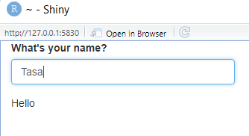
Exercise
This program is intended to insert the user's name after "Hello." However, the function does not work as expected. What is incorrect with this code?
library(shiny)
ui <- fluidPage(
textInput("names", "What’s your name?"),
textOutput("greeting")
)
server <- function(input, output){
output$greeting <- renderText({
paste0("Hello ", input$name)
})
}
shinyApp(ui, server)
Eh!! it’s not working !! What happen?

Slide 24
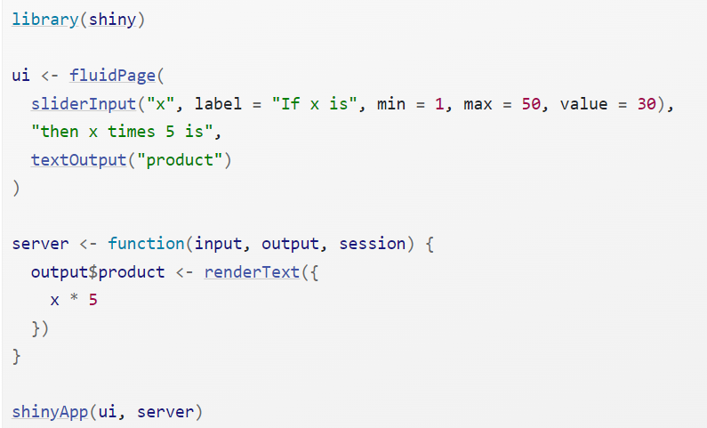
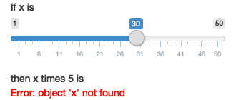
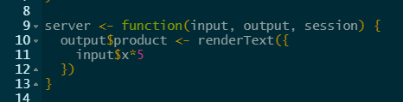
Exercise
Suppose your friend wants to create an app that allows the user to enter a number between 1 and 50 and displays the product of this number multiplied by 5. This is their initial effort: Unfortunately, there is an error. Can you assist them in locating and fixing the error?
Oh no~

Slide 25
Matching command in UI and server
library(shiny)
# Define UI for application that draws a histogram
ui <- fluidPage(
# Application title
titlePanel("Old Faithful Geyser Data"),
# Sidebar with a slider input for number of bins
sidebarLayout(
sidebarPanel(
sliderInput("bins",
"Number of bins:",
min = 1,
max = 50,
value = 30)
),
# Show a plot of the generated distribution
mainPanel(
plotOutput("distPlot")
)
)
)
# Define server logic required to draw a histogram
server <- function(input, output) {
output$distPlot <- renderPlot({
# generate bins based on input$bins from ui.R
x <- faithful[, 2]
bins <- seq(min(x), max(x), length.out = input$bins + 1)
# draw the histogram with the specified number of bins
hist(x, breaks = bins, col = 'darkgray', border = 'white’,
xlab = 'Waiting time to next eruption (in mins)’,
main = 'Histogram of waiting times’)
})}
# Run the application
shinyApp(ui = ui, server = server)
Each output function on the front end is coupled with a render function in the back end.
Each render{Type} function is often paired with a {type}Output function.
Commands in UI | Commands in server
dataTableOutput() | DT::renderDataTable(
imageOutput() | renderImage()
plotOutput() | renderPlot()
verbatimTextOutput() | renderPrint()
tableOutput() | renderTable()
textOutput() | renderText()
uiOutput() htmlOutput() | renderUI()
leafletOutput() | renderLeaflet()

Slide 26
Matching command in UI and server
Cheat sheet
Commands in UI | Commands in server
dataTableOutput(outputId) | DT::renderDataTable(expr, options, searchDelay, callback, escape, env, quoted, outputArgs)
imageOutput(outputId, width, height, click, dblclick, hover, brush, inline) | renderImage(expr, env, quoted, deleteFile, outputArgs)
plotOutput(outputId, width, height, click, dblclick, hover, brush, inline) | renderPlot(expr, width, height, res, …, alt, env, quoted, execOnResize, outputArgs)
verbatimTextOutput(outputId, placeholder) | renderPrint(expr, env, quoted, width, outputArgs)
tableOutput(outputId) | renderTable(expr, striped, hover, bordered, spacing, width, align, rownames, colnames, digits, na, …, env, quoted, outputArgs)
textOutput(outputId, container, inline) | renderText(expr, env, quoted, outputArgs, sep)
uiOutput(outputId, inline, container, …) htmlOutput(outputId, inline, container, …) | renderUI(expr, env, quoted, outputArgs)

Slide 27
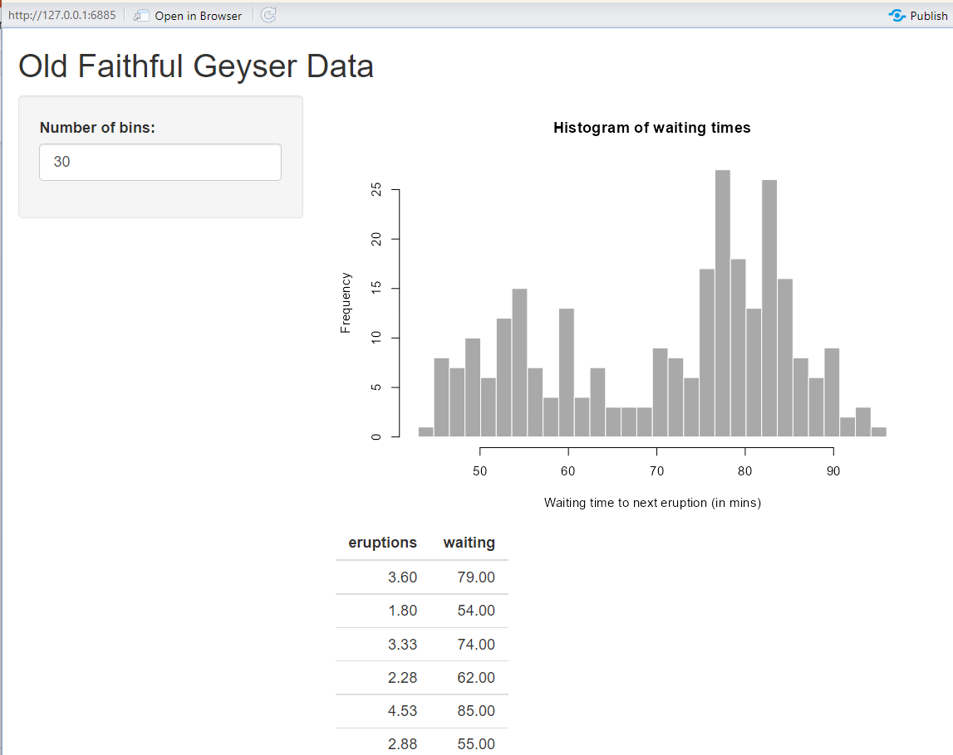
Matching command in UI and server
# Define UI for application that draws a histogram
ui <- fluidPage(
# Application title
titlePanel("Old Faithful Geyser Data"),
# Sidebar with a slider input for number of bins
sidebarLayout(
sidebarPanel(
sliderInput("bins",
"Number of bins:",
min = 1,
max = 50,
value = 30)
),
# Show a plot of the generated distribution
mainPanel(
plotOutput("distPlot"),
tableOutput(“distTable”)
)
)
)
# Define server logic required to draw a histogram
server <- function(input, output) {
output$distPlot <- renderPlot({
# generate bins based on input$bins from ui.R
x <- faithful[, 2]
bins <- seq(min(x), max(x), length.out = input$bins + 1)
# draw the histogram with the specified number of bins
hist(x, breaks = bins, col = 'darkgray', border = 'white’,
xlab = 'Waiting time to next eruption (in mins)’,
main = 'Histogram of waiting times’)
})
output$distTable <- renderTable({
y <- faithful
})
}
Let’s add the table in the mainPanel

Slide 28
Hands-on

Slide 29

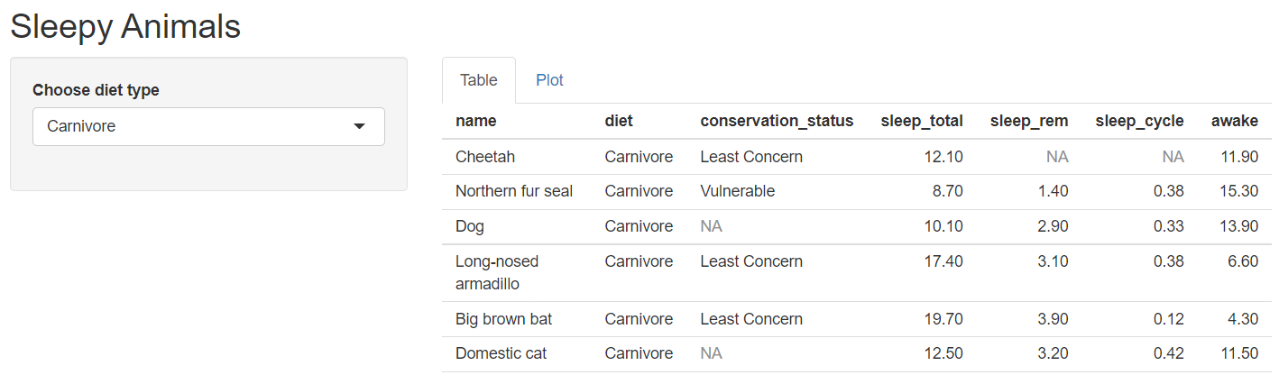
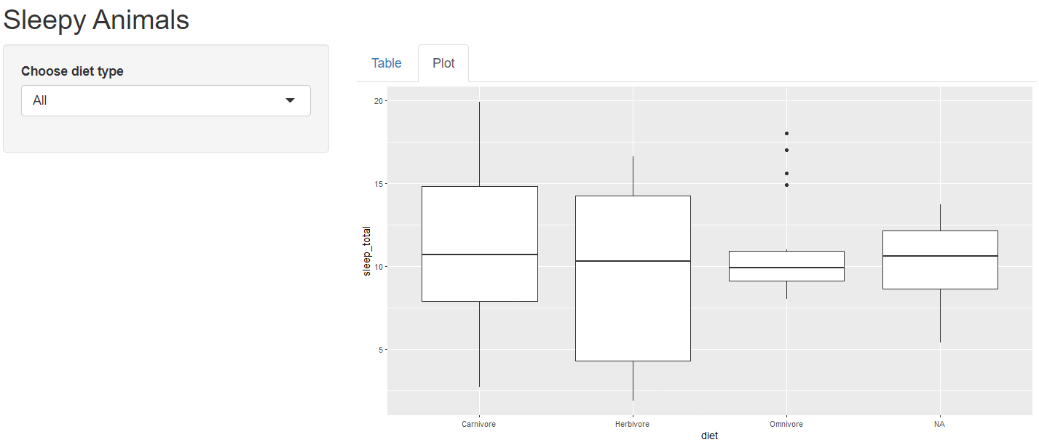
Sleepy animals App:
Structure of the app:
Under fluidpage
One title panel with the title "Sleepy Animals"
One side panel with select input
One main panel with 2 tabs for table and plot
Data: msleep (existing data in R) and conservation_explanation.csv

Slide 30
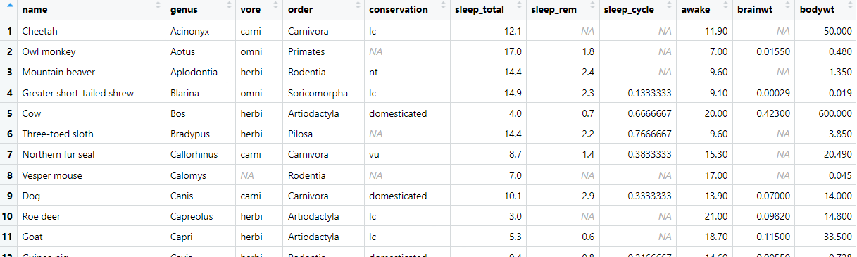
msleep data
Conservation data is in short form
Recode vore to diet and spell out the diet type
library(tidyverse)
view(msleep)

Slide 31
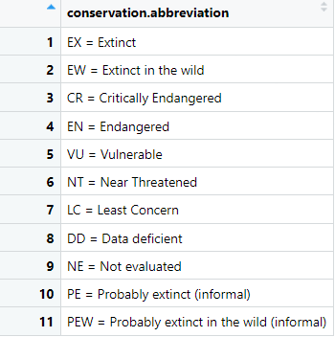
Loading of data
read_csv(): comma separated (CSV) files
read_excel(): xls and xlsx files
read_tsv(): tab separated files
read_delim(): general delimited files
#Method 1: copy the whole file path
#Remember to switch \ to /
conservation<-read.csv("C:/Users/User/Desktop/MITB Program/TA for ASAR/Workshop 1 handson/conservation_explanation.csv")
#Method 2: set working directory
#save the file in the same directory as R project
conservation <- read.csv("conservation_explanation.csv")

Slide 32
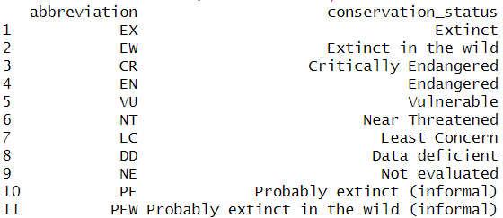
Separate columns: separate()
Separate() function requires:
Name of the existing column to separate (conservation abbreviation),
Desired column names of the resulting separated columns (into = c("abbreviation", "conservation_status"))
Characters that currently separate the pieces of information (sep = " = ")
# Separate abbreviation and description
conservation <-conservation %>%
separate(`conservation.abbreviation`,
into = c("abbreviation", "conservation_status"),
sep = " = ")
Notes:
Ctrl+Enter to run line by line

Slide 33
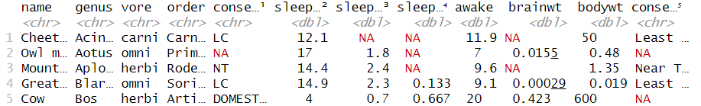
Join tables: join()
left _join(x, y): Return all rows from x, and all columns from x and y. Rows in x with no match in y will have NA values in the new columns. If there are multiple matches between x and y, all combinations of the matches are returned.
right_join(x, y): Same as left _join(y, x)
full_join(x, y): Return all rows and all columns that exist in x or in y. If there are non-matching values, return NA for the ones missing.
inner_join(x, y): Return all rows from x where there are matching values in y, and all columns from x and y. If there are multiple matches between x and y, all combination of the matches are returned.
# Left join msleep with conservation
##toupper() change to uppercase abbreviations
sleep_data <-msleep %>%
mutate(conservation = toupper(conservation)) %>%
left_join(conservation, by = c("conservation" = "abbreviation"))
Domesticated not in conserve data, hence, NA value under conservation status

Slide 34
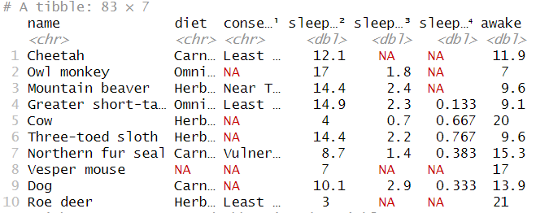
Create data for Rshiny
#view all unique values under column vore
unique(sleep_data$vore)
# Recode vore column
sleep_data<-sleep_data %>%
select(name, "diet"=vore, conservation_status, sleep_total:awake) %>%
mutate(diet=recode(diet,
carni="Carnivore",
omni="Omnivore",
herbi="Herbivore",
insecti="Carnivore"))

Slide 35
R shiny app structure
ui <-fluidPage(
titlePanel("Sleepy Animals"),
sidebarLayout(
sidebarPanel(),
mainPanel(
tabsetPanel(
tabPanel("Table"),
tabPanel("Plot")
)
)
)
)
server <-function(input, output) {
}
shinyApp(ui, server)
Structure of the app:
Under fluidpage
One title panel with the title "Sleepy Animals"
One side panel with select input
One main panel with 2 tabs for table and plot

Slide 36


R shiny widget
ui <-fluidPage(
# Copy the line below to make a select box selectInput("select", label = h3("Select box"),
choices = list("Choice 1" = 1, "Choice 2" = 2, "Choice 3" = 3),
selected = 1),
hr(),
fluidRow(column(3, verbatimTextOutput("value"))) )
server <-function(input, output) {
# You can access the value of the widget with input$select, e.g.
output$value <- renderPrint({ input$select })
}
shinyApp(ui, server)
https://shiny.rstudio.com/gallery/widget-gallery.html

Slide 37
tabPanel 1: Table
#Under sidebarPanel in ui
selectInput("diet",
label="Choose diet type",
choices = list("All","Carnivore", "Herbivore", "Omnivore"),
selected = "All")
Use the input from selectInput in sidebarPanel to feed to server
#Under server
output$table <-renderTable({
data<-sleep_data
if (input$diet !="All") {data <-sleep_data %>%
filter(diet==input$diet)}
data})
Server renders data table, which is the output that is displayed the main Panel
#Under 1st tabPanel
"Table", tableOutput("table")

Slide 38
tabPanel 2: Plot
#Under server
output$plot <-renderPlot({
data<-sleep_data
if (input$diet !="All") {
data <-sleep_data %>%
filter(diet==input$diet)
}
qplot(data=data, x=diet, y=sleep_total, geom="boxplot")
})
Server renders plot, which is the output that is displayed in the second tabPanel
#Under the 2nd tabPanel
"Plot", plotOutput("plot")

Slide 39
R shiny code
ui <- fluidPage(
titlePanel("Sleepy Animals"),
sidebarLayout(
sidebarPanel(
selectInput("diet",
label="Choose diet type",
choices = list("All","Carnivore", "Herbivore", "Omnivore"),
selected = "All")
),
mainPanel(
tabsetPanel(
tabPanel( "Table", tableOutput("table")),
tabPanel("Plot", plotOutput("plot")))
)
)
)
server <- function(input, output, session) {
output$table <-renderTable({
data<-sleep_data
if (input$diet !="All") {data <-sleep_data %>%
filter(diet==input$diet)}
data})
output$plot <-renderPlot({
data<-sleep_data
if (input$diet !="All") { data <-sleep_data %>%
filter(diet==input$diet)}
qplot(data=data, x=diet, y=sleep_total, geom="boxplot")
})
}
shinyApp(ui, server)
library(shiny)
library(tidyverse)
conservation<-read.csv("conservation_explanation.csv")
#Separating column using separate()
conservation <-conservation %>%
separate(`conservation.abbreviation`, into = c("abbreviation", "conservation_status"), sep = " = ")
#Combining data across data frames
sleep_data <-msleep %>%
mutate(conservation = toupper(conservation)) %>%
left_join(conservation, by = c("conservation" = "abbreviation"))
sleep_data<-sleep_data %>%
select(name, "diet"=vore, conservation_status, sleep_total:awake) %>%
mutate(diet=recode(diet,
carni="Carnivore",
omni="Omnivore",
herbi="Herbivore",
insecti="Carnivore"))

Slide 40



Resources for future dive in RShiny
Mastering Shiny, 2020, Hadley Wickham
Shiny Website
https://mastering-shiny.org/index.html
https://shiny.rstudio.com/articles/basics.html
Widgets and libraries
http://www.htmlwidgets.org/showcase_leaflet.html

Slide 41
All the best for your R Journey! Feel free to contact us if you have any question: Tasa: tasapornv.2021@mitb.smu.edu.sg Phuong: mphuynh.2022@mitb.smu.edu.sg
Last words…

